Slide 1


Welcome!
Missouri Department of Public Safety
Office for Victims of Crime
We will begin shortly.
This presentation will be recorded.

Slide 2
compliance Webinar
2026-2027
STOP Violence Against Women (VAWA)
Sexual Assault Services Program (SASP)
Notes:
Welcome to the 2026-2027 STOP VAWA & SASP Compliance Webinar! We are super excited about all your programs and look forward to supporting all of you!
We will cover a lot of material today and will entertain any questions at the end of the presentation. Please submit questions or comments in the Chat and follow up at the end of the presentation.
Today’s presentation will be recorded. The recording and the slide deck will be posted on the OVC in a few days.
We are officially kicking things off….

Slide 3

CONGRATULATIONS
If your subaward is not already underway, it should be very close!
If you have revisions due, please notify your Grants Officer through WebGrants Correspondence to provide a status update on your award as soon as possible.
Notes:
Congratulations to all of you! The VAWA and SASP awards are highly competitive and OVC historically receives far more requests that what we can fund.
Whether your application was fully funded or partially funded, we want you to know that the grant review panel conducted a very thorough review process. The decisions are always difficult, and many factors are taken into consideration in determining funding.
Please read and heed the feedback provided to you. Providing positive and constructive feedback to subrecipients is a key responsibility of the review panel. Considerable time is devoted to providing feedback intended to not only identify required adjustments, but to also assist you in strengthening your current award and future proposals.

Slide 4

VAwA & SASP Grants team
Tina Utley, Grants Specialist/Supervisor
        573-522-6235
        tina.utley@dps.mo.gov
Benjamin Johnson
        573-751-6145
        Benjamin.johnson@dps.mo.gov
Dawn Stilson
        573-522-5685
        dawn.stilson@dps.mo.gov
Connie Berhorst, Program Manager
        573-751-2771
        connie.berhorst@dps.mo.gov
Notes:
Introducing the 2026-2027 OVC Grants Team! If you haven’t already, you will receive a notification in WebGrants correspondence that identifies your agency’s Grants Officer. If you have any questions prior to that notification, please contact any OVC Grants Team member on this slide.

Slide 5


OUR COMMITTMENT:
YOU AND YOUR AGENCY
CAN EXPECT THE FOLLOWING
Timely responses to questions or requests for technical assistance related to your award
Thorough review of all award related claims, reports and correspondence
Performance reviews, compliance monitoring and accountability
Notification of any concerns related to the award
Notes:
The Grants Team is here to assist you in successfully implementing your program or project!
We encourage you to be proactive if you have any questions!
It is much easier to answer any questions or address any concerns sooner rather than later.

Slide 6

Webgrants communication
The primary method of communication is through the Correspondence component of WebGrants.
      All Agency contact info or personnel changes MUST BE submitted immediately
      All correspondence must Include your name, agency and direct phone number (similar to an email signature)
      To cc: a recipient, the e-mail address of the intended recipient must be entered
      Do Not Reply to e-mail alerts sent from WebGrants; your reply may not reach your intended recipient.
Notes:
To best assist you in a timely manner, all communication should be conducted through the WebGrants Correspondence component.
That does not mean you cannot email or call your Grants Officer.
We encourage you and welcome you contact us.

Slide 7
Primary grant purpose
Sexual Assault Services Program (SASP)
STOP VAWA (VAWA)
To support rape crisis centers and other nonprofit, non-governmental programs that provide direct intervention and related assistance to victims of sexual assault, without regard to the age of the individual.
To enhance the capacity of local communities to develop and strengthen effective law enforcement and prosecution strategies to combat violent crimes against women and to develop and strengthen victim services in cases involving violent crimes against women
Notes:
Much of today’s presentation applies to both SASP and VAWA; however, these two distinctly different funding streams.
VAWA and SASP have different purposes, guidelines and allowable costs.

Slide 8
Grant authorization
Sexual Assault Services Program (SASP)
STOP VAWA (VAWA)
Services Training Officers Prosecutors
VIOLENCE AGAINST WOMEN
The STOP VAWA Program was authorized under the Violence Against Women Act of 1994
2026-2027 VAWA NOFO
Performance Period:
1/1/2026-12/31/2027
CFDA# 16.588
The SASP Program was authorized by the Violence Against Women Act of 2005
2026-2027 SASP NOFO
Performance Period:
  1/1/2026-12/31/2027
  CFDA# 16.017
Awarded to DPS by the U.S. Department of Justice (DOJ)
Office on Violence Against Women (OVW)

Slide 9

Performance Period
January 1, 2026 through December 31, 2027
All projects MUST BE operational within 60 days of the project period start date.
  If not operational within 60 days, subrecipient MUST immediately submit notice to the Grants Officer via WebGrants Correspondence. The notice must provide a detailed explanation for the delay, an action plan to become compliant, the expected start date, OR notice to de-obligate the award.
  If not operational within 90 days, subrecipient will receive notice from the Grants Officer to schedule a call within 5 business days with the Project Director.
  IMPORTANT: DPS-OVC may terminate and/or reduce an award if the project is not operational within the timeframes noted above and/or the delay is not satisfactorily justified.
Notes:
Subrecipients are expected to begin your projects/program on January 1; however, we understand there are circumstances where there may be a slight delay.
A slight delay is….7-14 days! Every effort should be made to begin on time.
It is important to keep your Grants Officer updated if for ANY reason your project or program will not start on January 1.
A late start may require you to submit a Subaward Adjustment to ensure you meet the goals and objectives of your award.

Slide 10



RULES
REGULATIONS
ASSURANCES
GUIDELINES
(Get it…Lions, tigers & BearS)
Notes:
The next few slides will cover some of the “FINE PRINT” information! It can be overwhelming, like Lions and Tigers and Bears Oh My!
Awareness and adherence to this information:
Keeps agencies in good standing
Helps ensure the management of your award meets all the criterial necessary for compliance, and
More often than not explains why your Grants Officer asks questions or requests revisions or changes.

Slide 11
SYSTEM FOR AWARD MANAGEMENT (SAM) REGISTRATION
It is the responsibility of the subrecipient to:
Update the agency’s SAM (formerly CCR/Cage Code) registration yearly. See https://www.sam.gov/SAM/
  Immediately notify your Grants Officer of the Agency’s new expiration date via WebGrants Correspondence
  Failure to maintain an updated SAM and notify your Grants Officer may result a compliance issues.
  Agencies cannot edit organization information in WebGrants.
Notes:
THIS IS IMPORTANT! It is the agency’s responsibility to update/renew their information in SAM.gov and to update WebGrants accordingly.
The expiration dates are verified, so information must be accurate. If you need assistance, please reach out to your Grants Officer.

Slide 12

STANDARD requirements for
ALL OVC GRANTS
Comply with Federal Rules which regulate grant each award
Comply with State of Missouri Rules
Maintain State and Civil Rights requirements
Comply with Non-Discrimination requirements
Comply with Federal Fair Labor Standards Act
Provide access to services for persons with Limited English Proficiency (LEP)
Notes:
There are standard requirements, rules and regulations for all federal awards as well as State of Missouri awards. It’s important to have awareness to ensure you are compliant as applicable.

Slide 13

STATE OF MISSOURI
CIVIL RIGHTS REQUIREMENTS
Section 213.055 RSMo: Unlawful Employment Practices May not discriminate because of race, color, religion, national origin, sex, ancestry, age, or disability in its employment practices (e.g., hiring, compensation, conditions, or privileges)
Section 213.065 RSMo: Discrimination in Public Accommodations It is unlawful to refuse, withhold from, or deny any of the accommodations, advantages, facilities, services, or privileges made available in any place of public accommodations
Section 285.530.1 RSMo indicates that an agency will not knowingly employ, hire for employment, or continue to employ an unauthorized alien to perform work within the State of Missouri
Notes:
Unlawful Employment, Discrimination, Unauthorized Employment Statutes apply to all agencies receiving SASP or VAWA funds.

Slide 14
federal CIVIL RIGHTS REQUIREMENTS
All agencies must comply with Federal Civil Rights:
Title VI of the Civil Rights Act of 1964 (42 U.S.C. § 2000d)
Section 504 of the Rehabilitation Act of 1973 (29 U.S.C. § 794)
Title II of the Americans with Disabilities Act of 1990 (42 U.S.C. § § 12131-34)
Title IX of the Education Amendments of 1972 (21681, 1683, and 1685-860 U.S.C. § §)
Age Discrimination Act of 1975 (42 U.S.C. § § 6101-07)
U.S. Department of Justice Regulations – Non-Discrimination; Equal Employment Opportunity; Policies and Procedures (28 C.F.R. pt 42)
U.S. Department of Justice Regulations – Equal Treatment for Faith Based Organizations (28 C.F.R. pt 38)
U.S. Department of Justice Regulations – Nondiscrimination on the Basis of Sex in Education Programs or Activities Receiving Federal Financial Assistance (28 C.F.R. pt 54)
Executive Order 13279 (equal protection of the laws for faith-based and community organizations)
Executive Order 13559 (fundamental principles and policymaking criteria for partnerships with faith-based and other neighborhood organizations)
Notes:
The Feds also require adherence to civil rights requirements. Detailed information can be found in the United States Code, the Code of Federal Regulations and Executive Orders.

Slide 15

PROHIBITED
Certain activities/expenses are unallowable under these awards, for example:
Lobbying
Fundraising
  Note: grant writing is considered fundraising
Bonuses
Notes:
State and Federal funds CANNOT be used for Lobbying, Lobbyists or anything that may be construed as lobbying.
Employee/Agency Bonuses are unallowable.

Slide 16

VAWA LOCAL MATCH
A 25% minimum match is required for government agencies
  If providing greater than 25%, the budgeted amount must be fulfilled (i.e., if matching 35%, 35% is required)
Match may be applied to the same eligible expenses as the Federal funds approved in the budget
Match must be submitted within 60 days of being incurred to be credited to the subaward
Adjustments to match reporting throughout the performance period may be required (i.e., agency is significantly behind in providing match, so funds are moved from reimbursement to match)
Notes:
As a requirement of the STOP VAWA funding, a 25% local match is required for governmental agencies only.
NOTICE: Here’s another 60-day notice!

Slide 17

VAWA VOUNTEER MATCH
    Volunteers must provide eligible/allowable services and/or complete eligible activities to be allowed as match
    Paid staff cannot volunteer their time
    A Volunteer Daily Activity Timesheets is required to be considered for match and must:
      Include detailed services/activities
      Be signed by both volunteer and supervisor
      (a handwritten or electronic signature is required; a typed name is unacceptable)
Notes:
Again, match is only required for governmental agencies and the VAWA grant. SASP does not require match.

Slide 18

MORE HEAVY STUFF
Notes:
While equally as important as the Unlawful Employment, Discrimination, Unauthorized Employment Statutes; the next few slides are not quite as harrowing at the previous few slides.
These slides and references are more likely to assist you in the day-to-day management of your award.

Slide 19
Grant guidelines & requirements
  The DPS Financial and Administrative Guidelines
  The Office of Justice Programs (OJP) Financial Guide
  The DPS Subrecipient Travel Policy
  The Subaward specific applicable 2026-2027 Certified Assurances
  Any Subaward Specific Special Conditions
  Annual Performance Reporting Requirements
  All Claim Request Requirements
  Subaward Budget Modification Requirements
  Subaward Programmatic Modification Requirements
Notes:
Add link to CA’s
Anyone responsible for the administration of the subaward must be cognizant of the content of these documents and is accountable for ensuring the project operates within these guidelines and assurances. For example, the Authorized Official, the Project Director and the Fiscal Contact.
FAILURE TO ADHERE TO ANY OF THE ABOVE (AS APPLICABLE) MAY RESULT IN NON-COMPLIANCE!
Adherence to this guidelines and requirements should discussed among anyone involved in the management and administration of the award, both the programmatic side as well as the administrative side.

Slide 20


SUPPLANTING IS RESTRICTED
Federal funds must be used to supplement existing State and local funds for program activities and must not supplant those funds that have been appropriated for the same purpose
Supplanting will be reviewed during the application process, post-award monitoring, and audit
Supplanting must be adequately addressed in the applicable budget justification sections
NOTE: Funds may be used in conjunction with other funds but shall not supplant (or replace) other funds
Notes:
Supplanting Restrictions apply to both federal and state funds. This is an area that is sometimes difficult for anyone unfamiliar or new to administering grants AND this is most often overlooked. Connect with your Grants Officer if you need more information. Supplanting means an organization stops using its own local or state money for a program because a new source of funds (like a federal grant) is available to pay for it instead.

Slide 21
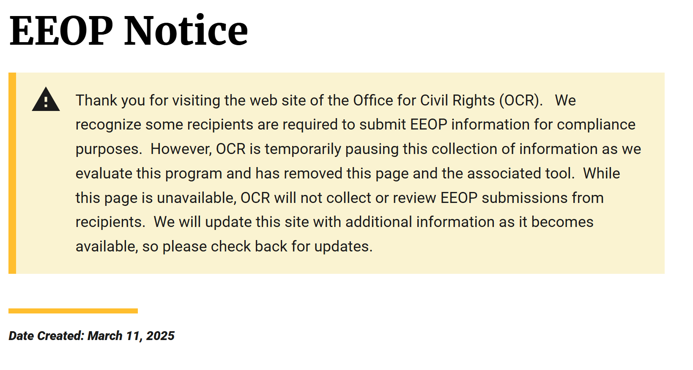
EQUAL EMPLOYMENT OPPORTUNITY PLAN (EEOP)
See the OCR’s EEOP Website for more information:
Notes:
This slide is for your awareness. Effective March of 2025; Federal EEOP Requirements have changed but it’s important to be familiar with the OCR and EEOP information.

Slide 22

Subrecipient INTERNAL CONTROLS
Subaward Recipients are required to ensure appropriate internal controls exist for the programmatic and financial aspects of the project; this can be accomplished through, but not limited to, the following method:
Subaward Recipients are encouraged to include the Agency Authorized Official, Project Director and Fiscal Officer in reviewing all Claims, Subaward Adjustment Requests and required reporting.
  Must track, account for, and report on all funds separately from any other funds
  Grant funds may be used in conjunction (no supplanting) with other funding as necessary to complete projects but tracking and reporting must be separate
Notes:
As a Project Director, you may or may not be aware of your agencies Internal Controls. If you are that’s GREAT!
If not, become familiar!
Each agency must have a clear separation of duties (or layers), both programmatic and financial.
All grant funds MUST BE TRACKED SEPERATELY for any other funds and the agency may be asked to produce this level of accounting.
When it comes to the approval of timesheets/payroll, purchase approvals and payments there should be a CLEAR separation of duties.
Example: One person enters the claim details, a second person approves the claim, and a third person processes the payment and reconciles the bank statement.

Slide 23

State PROCUREMENT policy
Local procurement practices of federally-funded Subrecipients must adhere to the procurement standards applicable to their organization type:
  State and Local Governments – Procurement Standards in the Uniform Guidance at 2 C.F.R. § 200.317 through 2 C.F.R. § 200.326.
  Non-Profit Organizations – OMB Circular A-110, “Uniform Administrative Requirements for Grants and Other Agreements with Institutions of Higher Education, Hospitals, and Other Nonprofit Organizations, relocated at 2 CFR, Part 215
  For more information, see the page 7 of the DPS Financial and Administrative Guidelines.
Notes:
As a Subrecipient, the agency assures all procurement transactions negotiated or competitively bid and without regard to dollar value shall be conducted in a manner to provide maximum open and free competition.
It must be determined that the item to be purchased is an approved budget item (approved by the Missouri Department of Public Safety and shown in the approved project budget), that any necessary prior approval has been obtained, that no other item owned by the Subrecipient is available for the purpose, and that sufficient funds are in the budget to cover the cost of such item.

Slide 24

Reporting fraud
Subrecipients, or employees thereof, must promptly notify the Missouri Department of Public Safety of any credible evidence that an employee, contractor, or other person has submitted a false claim for grant funds or has committed a criminal or civil violation of laws pertaining to the fraud, conflict of interest, bribery, gratuity, or similar misconduct involving grant funds
In event it is determined the recipient made false statements relating to a position or annual salary in order to receive funding, action may be taken as deemed appropriate to recover any portion of the grant funds remaining and/or an amount equal to the portion of the grant funds wrongfully use
Notes:
Nobody wants to go to jail!
Not so fun fact: The federal government loses between $233 billion and $521 billion annually to fraud, according to estimates from the Government Accountability Office (GAO) based on data from fiscal years 2018-2022

Slide 25

Audit requirements
State and local units of government, institutions of higher education, and other nonprofit institutions, must comply with the organizational audit requirements the DOJ Financial Guide, Chapter 3.19, Audit Requirement, in accordance with the provisions of of 2 CFR Part 200 Subpart F, (§ 200.500 et seq.)
Subrecipients expending $1,000,000 or more of federal funds during the fiscal year are required to submit a single organization wide financial and compliance audit report (single audit) to the Federal Audit Clearinghouse within 9 months after the close of each fiscal year during the term of the award. See the Federal Audit Clearinghouse (FAC) for more information.
  NOTE: Expended funds include all Federal funds received by the Subrecipient, not just SASP, VAWA . Other sources such as VOCA.
Notes:
Federal funding audits are based on the organization or agency, not the VAWA or SASP funded project.

Slide 26

More about Audit requirements
An agency audit must be performed by an independent auditing firm
Audits must be conducted with reasonable frequency, usually annually, but no less frequently than every two years
Must submit a copy of such audit to DPS via the “Correspondence” component of WebGrants
Notes:
An Audit is required of the agency if $1,000,000 or more is received from Federal sources and $250,000 or more in state funds during the fiscal year.
Federal funding is based the organization, not the VAWA and/or SASP funded project.
Audits must be uploaded to WebGrants Correspondence. If you need technical assistance, please reach out to your Grants Officer.

Slide 27

TERMINATION OF AWARD
DPS reserves the right to terminate any award entered into resulting from an approved application, at their sole choice and without penalty or recourse, by issuing written notice to the sub recipient of the effective date of termination.
In the event it is determined that a subrecipient is operating in a manner inconsistent with the provisions of the award or is failing to comply with the applicable state and federal requirements governing VAWA or SASP funds, the award may be permanently or temporarily terminated.
In the event an award is permanently terminated, action as deemed appropriate, may be taken to recover any portion of the funds remaining and/or an amount equal to the portion of the funds wrongfully used
Notes:
While unusual, unfortunately this is sometimes a reality.

Slide 28

Let’s Get Started
Notes:
While unusual, unfortunately this is sometimes a reality.

Slide 29

DOWNLOADING THE SUBAWARD AGREEMENT
Log into WebGrants:
Select “Subaward Documents – Need Signatures”
  Download and/or print these forms for signature
  NOTE: If the Agency Authorized Official or Project Director has changed from the name on the submitted application contact your Grants Officer immediately for guidance

Slide 30

SUBAWARD DOCUMENTS
  The subaward agreement MUST be signed by the Agency Authorized Official and Project Director identified on the application
  Each page of the Certified Assurances MUST be initialed by the Agency Authorized Official identified on the application
  The signed subaward agreement MUST be submitted to DPS OVC within 14 days from the date it was delivered to the subrecipient
Notes:
A fully executed or signed Subaward Agreement is the GOAL #1! This is where deadlines are REALLY IMPORTANT!
If for any reason the agency cannot submit the fully signed subaward agreement to OVC within 14 days of receipt, you must notify your Grants Officer.

Slide 31

SUBAWARD DOCUMENTS signatures
Electronic Signatures are Acceptable
The Authorized Official and Project Director may sign subaward documents with either a handwritten signature or a digital signature. Stamped or typed signatures are not acceptable.
ALL SIGNATURE FIELDS MUST BE COMPLETED ON THE SUBAWARD AGREEMENT AND THE CERTIFIED ASSURANCES
The Authorized Official must also initial each page of the Certified Assurance.
NOTE: The person signing the subaward documents must match the typed name on the application. If not, contact your Grants Officer immediately for guidance.
Notes:
Before submitting the subaward agreement, please double and triple check that all required signatures are in all the right places!

Slide 32
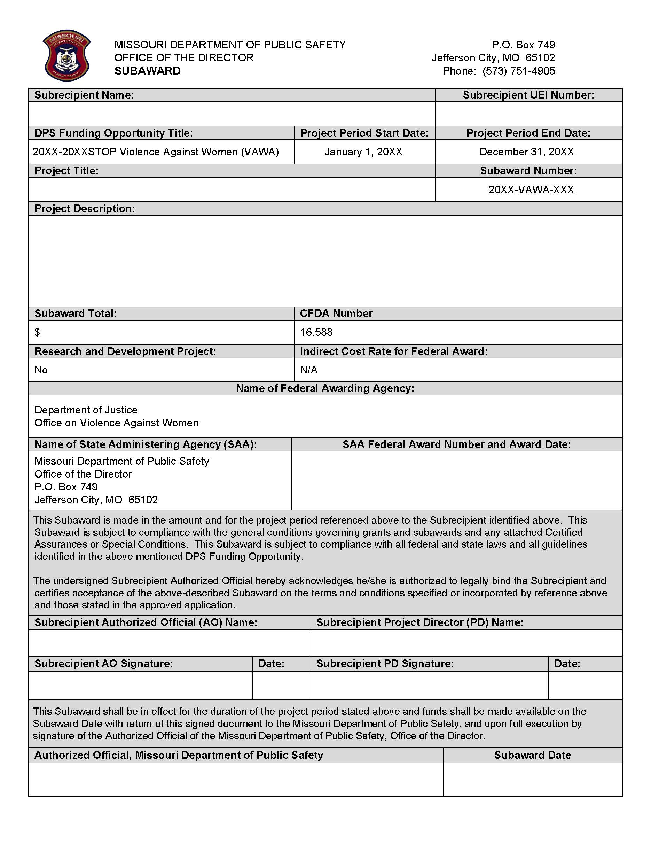

This is what the SUBAWARD document looks like
Notes:
Please review this document carefully to ensure the correct authorized official and project director is identified. The printed names must match the signature!

Slide 33

FINAL subaward document approval Process
Signed subaward documents are verified by DPS-OVC and then submitted to DPS Administration for final review & approval
If approved, subawards are moved to “Underway” status in WebGrants
Approved subaward documents are available for download in WebGrants under “Subaward Documents – Final”
IMPORTANT: Print the final fully signed documents and keep for your records!
Notes:
Here is the process! DPS-OVC makes every effort to process the subaward documents as quickly as possible. You will be notified via WebGrants Correspondence of the status of your award.
REMEMBER TO PRINT A HARD COPY FOR OUR RECORDS and ROUTE TO THE APPROPRIATE PERSONNEL IN YOUR AGENCY!

Slide 34


Award responsibility & understanding
The Agency Authorized Official, Project Director, and Fiscal Contact
MUST HAVE A CLEAR UNDERSTANDING & FAMILIARITY WITH THE FOLLOWING:
The OVC approved BUDGET of the project
The SCOPE of the project as outlined in the subaward
Any subaward specific SPECIAL CONDITIONS
The CERTIFIED ASSURANCES
All compliance requirements previously discussed
Notes:
This slide may seem a bit repetitive, because it is! This information is CRITICAL to successful management of the subaward.
If anyone else in the agency is involved in the management of the subaward, you are encouraged to loop them into these responsibilities as well.

Slide 35

ovc grant resources
Resources are available! Visit the following sites for help tips and information:
VAWA
SASP
  WebGrants Subgrantee manual
  Helpful tips for navigating WebGrants
  Site Visit FAQ
  Claims 101
  Subaward Adjustments 101
  Annual Report Information
Notes:
THESE 101’S NEED BE PREPARED ASAP & Add links
Use these links to assist you in navigating the resource available that provide detailed technical assistance. If you need further instructions, please contact your Grants Officer through WebGrants Correspondence.

Slide 36

WEBGRANTS USER
MANAGEMENT & security
It is the Agency’s responsibility manage and maintain Registered WebGrants User access to the subaward:
Review agency’s Registered Users periodically
  Go to Main Menu→, then →My Profile
  Select your Agency Name from Associated Organization:
      The agency profile page opens
      Scroll down to view the list of Registered Users
      Made required changes as applicable
Registered users no longer associated with the agency/organization MUST BE removed promptly
    To remove a user, notify your Grants Officer immediately
Notes:
The agency is responsible for maintaining users registered in WebGrants! Routine review and maintenance of Users associated with the agency is key to keeping your agencies financial information, personal identification information for employees, etc. secure..
It important to promptly remove anyone who is not authorized to access the subaward information in WebGrants.

Slide 37

ACCOUNTING/FINANCIAL
RECORDS RETENTION
The agency must keep records in an orderly manner and make available for audit/monitoring purposes
Records must be available to DPS-OVC and/or other representatives of the State of Missouri or federal government
      Records must be maintained for 3 years
        see Audit Requirements and Retention Policies
The agency is responsible for protecting records against fire, theft, or other possible damages
Notes:
Per 2 C.F.R. §200.334: Recipients and subrecipients must retain all federal award records for a period of 3 years from the date of submission of the final expenditure report
Retention is required for purposes of State and Federal examination and audit.
Records may be retained in an electronic format.
Coverage
The retention requirement includes, if applicable:
books of original entry
source documents
supporting accounting transactions
general ledger & subsidiary ledgers,
personnel and payroll records
cancelled checks, and related documents and records.
Time and effort reports

Slide 38


CLAIMS and
SUPPORTING DOCUMENTATION

Slide 39
FUNDS DISTRIBUTION BASICS
Reimbursement only
Expense must be specifically identified in the approved budget
Funds must be paid or officially obligated by the agency PRIOR to requesting reimbursement
Funds are considered obligated if an official purchase order is issued by the agency (dated & signed)
Supporting documentation must be provided
Travel/Training requests CANNOT be claimed until AFTER the approved travel has been completed
When in doubt, contact to your Grants Officer
Notes:
This slide covers the basic funds distribution.

Slide 40

60 DAY WARNING
Claims for reimbursement must be submitted within 60 days of expense being incurred. Claims submitted past the 60 days are not eligible for reimbursement
Supporting documentation must be included
Failure to submit expenses within 60 days may result in reimbursement being denied
Notes:
Pay particular attention to this notice! In rare circumstances would any claim not submitted within 60 days be reimbursed.

Slide 41

THE MOST COMMON CLAIM ERRORS ARE IN
PERSONNEL AND FRINGE BENEFITS
REVIEW OF PERSONNEL & FRINGES ARE THE MOST TIME CONSUMING AND THE MOST LIKELY TO CAUSE DELAYS TO REIMBURSEMENT
READ THIS SECTION CAREFULLY,
MEET ALL THESE REQUIREMENTS &
AVOID UNNECESSARY DELAYS
CHECK FOR ACCURACY
BEFORE
SUBMITTING CLAIMS
Notes:
Every effort should be made to ensure that all claims are accurate; however, submitting personnel and fringe requests requires extreme attention to detail. Verify against the budget, be aware of any changes in personnel & fringes and then check, re-check and then check again. We aim to reimburse agencies as promptly as possible, when the claims come in accurate the first time the process goes much smoothly, and delays can be avoided.

Slide 42

PERSONNEL
TIMESHEETS & ACTIVITY TRACKING
Grant funded employee’s time MUST be accurately tracked and reported
Activity timesheets must be kept by pay period, be signed by both employee and supervisor
100% of time must be tracked, regardless of percentage being claimed
  All paid hours, (paid time off (PTO, overtime, etc.) must be documented even if the time is not charged to the grant
Time worked on ineligible activities (including VOCA) should be recorded as “Non-Allowable” hours on the Daily Activity Timesheet
Time listed as “Other Allowable Hours” requires a description of the activity
Notes:
The Daily Activities Timesheet is different than a Time & Accounting Record.
The Daily Activities Timesheets tracks everything a grant funded employee does, when and for how long (date, timeframe & action type).
The Time & Accounting Records must have a handwritten or electronic signature! Typing you name is not acceptable (the fed’s say so—don’t shoot the messenger). The Time & Accounting Records are the records that the agency uses to determine your payroll hours (regular time, overtime, vacation/sick leave, etc.).

Slide 43
PERSONNel & Benefits
The allowable % claimed for salary and benefits CANNOT EXCEED the eligible % calculated by the WebGrants Activity Timesheet for the corresponding pay period
Example: If 80% is the budgeted amount and the activity timesheet is calculated at 100%, you may claim either 100% or 80% for the corresponding time period. If you claim 100%, be aware you may encounter issues as the budgeted amount will be fully expended)
Payee – The payee must be the individual person or entity the payment was made to
  Note: A grant funded employee IS NOT the recipient of the agency’s fringe benefit payments. Please list the payee as IRS, MEM, Blue Cross, etc.
Notes:
Salary and fringes may be claimed at the budgeted % or less , as long as the WebGrants Activity Timesheet supports the same %

Slide 44

PERSONEL AND FRINGE BENEFITS
SUPPORTING DOCUMENTATION
The following MUST BE submitted for salary and benefit claims for reimbursement:
Daily Activity Timesheets (the work type completed)
Payroll/accounting records, paystubs, invoices, etc.
Worker’s Comp and Unemployment Comp RATES, etc. must be clearly identified (if applicable)
Proof of payment must be provided, whether paid monthly, quarterly, etc.
Bonuses are not allowable expenses
Notes:
Describe a good Daily Activity Sheet

Slide 45

TRAVEL/TRAINING
Will NOT be reimbursed prior to actual travel
Must use the most practical and direct route, with strict adherence to the DPS Subrecipient Travel Guidelines and the approved project budget
Costs must be reasonable, and prudence should be used when making any travel arrangements
  “Non-traditional” lodging is not allowable; lodging requests must be for a traditional lodging only (hotel)
A certificate of attendance or other proof of the individual’s attendance must accompany training reimbursement requests
Notes:
Travel expenses are not considered obligated until the trip has been completed. For instance, you can not pre-pay for a conference being held in August and claim the cost in July, even if the expense was paid in July.

Slide 46
TRAVEL/TRAINING
Pre-approved Travel/Training expenses must adhere to the approved budget
  If you foresee any eligible expenses not included in your budget, consider a subaward adjustment request in advance of traveling (Note: all adjustments require a 30-day notice)
Miscellaneous training requests must be submitted to your Grants Officer at least 30 days prior to the training for review
  Include as much information about the training as possible for your Grants Officer to determine allowability
  Requested Subaward Adjustments must be officially approved prior to proceeding with any changes
Notes:
Information related to miscellaneous travel request must include at a minimum: name of person traveling, date(s) of travel, destination, purpose & how it fits the project, estimated costs, agenda.
For reimbursement of miscellaneous travel, confirmation of attendance is required.

Slide 47

TRAVEL/TRAINING
State per diem guidelines must be followed, unless your agency policy is more restrictive
Per diem associated with location must be utilized, see https://acct.oa.mo.gov/state-employees/travel-portal/meals-per-diem for State of Missouri rates.
Mileage expenses must be supported by a log or other tracking system
  Must include employee name, number of miles driven/odometer readings, and purpose of travel
Meal/hotel expenses are only eligible if in a 12-hour travel status
Meals provided at hotels/trainings are not reimbursable
Notes:
If your agency’s travel policy is stricter than the State’s, you must follow the agency’s travel policy.
State per diem rates for hotels and meals must be followed; including that locations (i.e., if you live in St. Louis, but you were in a 12-hour travel status and had dinner in Jefferson City—then you apply the Jefferson City per diem rate.)
Meal per diem is only eligible if the person traveling is in a 12-hour travel status.
Meals provided at hotels or training are not reimbursable
Receipts are not required, please do not send any

Slide 48




SUPPLIES/OPERATIONS
Printed/media material must be pre-approved and must acknowledge the funding source. Failure to request approval may result in non-compliance and/or denial of reimbursement
    Reference the Certified Assurances for required language
An “office supply list” is included in the corresponding Notice of Funding Opportunity
    The list consists of generic items of approved office supplies
  Items not specifically included on the “office supply list” must have an approved budget line
Notes:
Supplies/Operations—this pretty self explanatory, but we encourage you to review the Supplies list found in the Notice of Funding Opportunity.
Printed/Media Material is bit of a different situation. Any printed material must be pre-approved, budgeted for and must include federally required langage cited in the Certificated Assurances.

Slide 49



EQUIPMENT
Equipment is defined as non-expendable personal property having a useful life of more than one year, and an acquisition cost of $5,000 or more per unit
Must be recorded and tracked in an Inventory Control Listing, as well as tagged to reflect the source of funding, where possible
Subrecipient must adhere to the most restrictive procurement policy (either DPS or agency policy)
Notes:
Recording and tracking documents are subject to review in monitoring.

Slide 50

CONTRACTUAL
Includes contractual/consultant fees/expenses
All contractual/consultant services must be supported by contracts
  Must state services to be performed, rate of compensation, and length of time the services will be performed, as applicable
A fully executed contract must be submitted to DPS prior to expenses being reimbursed
Subrecipient must adhere to the most restrictive procurement policy (either DPS or agency policy)
Notes:
STOP and VAWA funds generally should not be used to support contract services. At times, however, it may be necessary for subrecipients to use a portion of VAWA or SASP funds to contract for specialized services. Examples may include therapy, emergency psychological or psychiatric services, sign and/or interpretation for the deaf or for crime victims whose primary language is not English.
The daily rate of compensation for contractual services may not exceed $650/day ($81.25/hour) and must be in included the approved budget.

Slide 51
CLAIMS
Monthly Claims are due the 5th of each month
  If the 5th falls on a weekend or holiday, the claim is due the next business day
Monthly Claims must be submitted, even if $0.00 An explanation of any $0.00 claims must be included
Payments are generally made around the 25th of each month via EFT transaction
        Payments can be tracked using the State of Missouri Vendor Services Portal at:
https://www.vendorservices.mo.gov/vendorservices/Portal/Default.aspx
Enter your agency FEIN Number to search payments
Notes:
Claims can be initiated as soon as the award is moved to and “underway” status.
Claims are due the 5th of each month, unless the 5th falls on a weekend or holiday. In these cases, the next business day is the due date.
EACH SUBRECIPIENT MUST SUBMIT A MONTHLY CLAIM EVEN IF IT IS A $0.00 CLAIM
Your claim may be copied each month, however, please make sure the information is updated accordingly
Check the feedback section at the bottom of the prior claim before completing a new claim.

Slide 52
CLAIMS
Report only expenses incurred during the performance period
Include only items approved in the budget
REVIEW the Claim before submitting!
FEEDBACK
  After claim is approved, check the bottom of the claim for feedback. This may explain corrections made or provide instruction for submitting future claims.
Notes:
It’s important to review claims carefully before submitting! Taking your time and checking your math will save time in the long run!
Math is a big deal! Due Dates are a big deal! Approved expenses are big a deal! Supporting documentation is a big deal.

Slide 53

CLAIMS
Must report actual expenditures
Must be submitted via the “Claims” component of WebGrants
Expenses must be claimed within 60 days of occurrence
All funds must be obligated by no later than 12/31/2027
All funds must be expended no later than 02/05/2028
Final Claims are due no later than 02/05/2028
REMINDER: A CLAIM MUST BE SUBMITTED EVEN IF THERE IS $0.00 CLAIMED. $0.00 CLAIMS REQUIRE EXPLANATION.

Slide 54

Subaward Adjustments
At anytime there are concerns about the health of your project/program, please contact your grants officer immediately
There are two types of Subaward Adjustments: Programmatic & Budget
Be prepared to describe and detail the concerns
Your Grant Officer is available to assist you and explore strategies and solutions with you to ensure you successfully fulfill you award obligations
Notes:
Subaward Adjustments are designed to allow some flexibility through the life of your subaward.
We understand that sometimes things don’t go as planned or unforeseen circumstances require adjustments

Slide 55
SUBAWARD ADJUSTMENTs
Changes in Information or Updates that DO NOT require a Subaward Adjustment include:
Change of agency Address
Change of Authorized Official, Project Director, Fiscal Contact
        NOTE: Require official documentation, contact your Grants Officer for guidance.
Changes in grant funded staff (unless the budget is impacted)
Informal moves of <10%
(excluding moving $ into Personnel/Benefits)
Notes:
NOTE:
Any changes described here must be sent to your Grants Officer via WebGrants Correspondence immediately.
If there is a change in the AO/PD/FC, official documentation describing the change that is signed and on letterhead must be submitted to your Grants Officer
Any changes in grant funded staff may also require updates to the personnel and fringe budget lines

Slide 56

Subaward Adjustments
Budget Adjustments
  Must be received at least 30 days prior to the change taking place and at least 60 days prior to the end of the contract period
  Budget Revisions are NOT retroactive or guaranteed
  A maximum of two subaward adjustments are allowed during the project period
  Must be submitted if the agency is requesting to move funds into Personnel and/or Fringe Benefits or moving more than 10% of the award
Notes:
Budget Adjustments can be time consuming! If you need to talk through your scenario first, please contact your Grants Officer for Guidance. The last thing we want you to experience is multiple negotiations back and forth. A word about Subaward Adjustments:
Only Two are allowed during the performance period
Must be submitted at least 30 days prior to the change taking place
Must be submitted at least 60 days prior to the end of the performance period
Budget adjustments are NOT retroactive in most circumstances

Slide 57
Subaward Adjustments
Programmatic Changes
Any change that affects the project, but not necessarily the budget
    Examples: project/program or title change, agency name change, etc.
Contact your Grants Officer if you are unsure whether a subaward adjustment is required

Slide 58

MANDATORY ANNUAL REPORTS
Report 1: Due January 30, 2027
Performance Period of 1/1/26-12/31/26
Report 2: Due January 30, 2028
Performance Period of 1/1/27-12/31-27
Late Reports may result in:
Suspension of Outstanding Payments
Termination of Subaward
Jeopardized Eligibility for Future Funding
Notes:
Annual Reports are MANDATORY
Annual Reports are Due January 30, 2027

Slide 59

MANDATORY ANNUAL REPORTS
PRO TIPS:
Start Preparing Now
Review Report Form Requirements Now
Develop a Monthly Logging/Tracking System
Develop Report of Success Measurement Tools
Prepare to Provide Measurement Tool Data
Verify Data is Accurate
IF YOU DON’T KNOW ASK
Notes:
Subrecipients are STRONGLY encouraged to develop a monthly tracking mechanism! Collecting data monthly will pay off when the deadline creeps up!

Slide 60
MANDATORY ANNUAL REPORTS
There are 2 Annual Reports Required per year
One Federal Report and One WebGrants Report
Annual Reports
Capture funding percentages by type
Capture Staffing/FTE data
Capture Training data
Capture Community Response data
Capture Victims Served/Not Served & More…
Requires Multiple Choice & Narrative Entries
These can be overwhelming! Help is Available!
Notes:
This report can feel like a BEAST! You will ABSOLUTELY want to prepare for collecting this data ASAP!
Fear not…with planning and guidance from your Grants Officer you will survive the reporting process!
We cannot stress enough how important it is for you to collect data monthly and so you meet the deadline!
FUN FACT: This report is required by the Fed’s, subrecipients MUST SUBMIT and SUBMIT ON TIME!
The good news is there is very little deviation of requirements from year to year to year!

Slide 61

MONITORING
Purpose
To comply with federal/state laws, regulations, and guidelines
    Provide technical assistance
    Review progress toward goals and objectives
How do we do this?
    On-Site Monitoring – visit your agency’s location to review policies, procedures, records, meet staff, and tour the facility
    Desk Monitoring – Require you to send all requested reports and documentation for DPS OVC to review electronically.

Slide 62
MONITORING
  What to Expect
  On Site Monitoring
  Subrecipients will be contacted by DPS to set up a date and time.
    A confirmation letter will be sent via WebGrants Correspondence to confirm date and time of visit
    A Site Monitoring Report must be completed and submitted via WebGrants prior to the visit
  Desk Monitoring
  Subrecipients will be contacted by DPS with instructions
  A Site Monitoring Report MUST be completed and submitted via WebGrants
Notes:
We make every effort to provide ample notice of On-Site and Desk Monitoring; however, there may be circumstances that require monitoring at any time during the performance period.
On the flip side; if you are new or have undergone significant changes withing your agency. You can also request a monitoring visit to make sure you’re on track!

Slide 63
MONITORING
  Notice of Monitoring Results
  Your agency will be notified via WebGrants Correspondence of the results of the monitoring event, including any corrective action that may be required.

Slide 64


PUBLICITY
OVC encourages subrecipients to share success stories about your projects and program
Let your community know you received an award & what your agency is about
Communicate advancements or improvements in access, services and delivery
Promote educational training/certifications
Subrecipients are required to disclose the source of their funding
Share your success stories with your community! Share your success with DPS-OVC!!!
Notes:
This is a nice way to garner support from the community, involves stakeholders, a way to promote/motivate staff.
NOTE: Any printed material or publicity must cite the funding source(s); including social media.

Slide 65

THANK YOU!
We look forward to working with you and wish each of success as you continue to serve Missouri victims of crime!

Slide 66

Notes:
Please submit you questions in the chat. All questions and response will be captured and added to the FAQ’s portion of this presentation. The presentation will be recorded and available on the OVC website withing a few days.

Slide 67
Compliance Webinar FAQ’s
Does an electronic signature work for the signed timesheets?
  Yes, must be signed by both the employee and supervisor. It must be a real signature, not a typed name!
Is there a specific form to be completed for changes to AO or PD?
  No! You will need to send a correspondence via WebGrants Correspondence to your Grants Officer; you will be contacted if additional information is required.
What is the minimum age for primary victims that can be served?
  SASP required all ages to be served.
  The STOP VAWA age minimum is 11 years.
What is considered “non-traditional” lodging?
  Private rental properties (Airbnb; VRBO’s, etc.) non-traditional lodging and are unallowable.

Slide 68
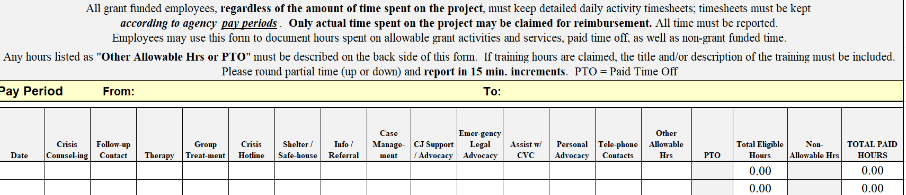
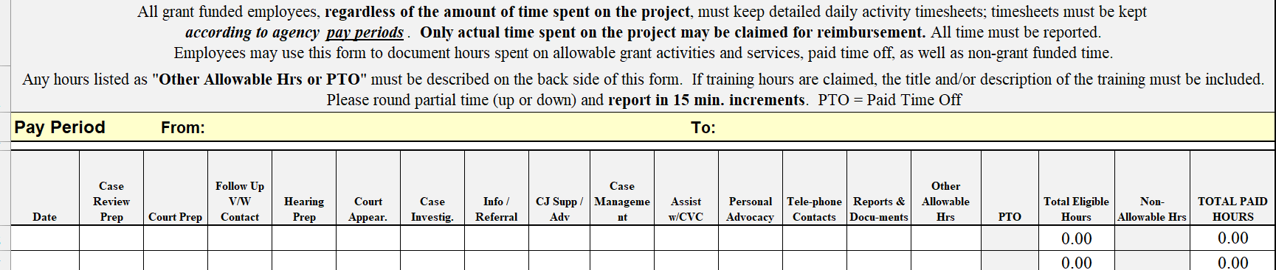
Compliance Webinar FAQ’s
Do you have daily activity logs/timesheets you can share?
  Yes, we do! STOP VAWA has two activity timesheets available on the
  OVC Website.
  Daily Activity Timesheet (Victim Services)
  Daily Activity Timesheet (Criminal Justice/Law Enforcement)
Notes:
Therea are two different report forms! The victim services form applies to all STOP VAWA Awards.
The Criminal Justice and Law Enforcement form only applies to Courts, Prosecuting Attorney Offices and Law Enforcement.

