Slide 1
Local Violent crime Prevention (LVCP) Grant
SFY 2023 Application Workshop

Slide 2
SFY 2023 Local Violent Crime Prevention (LVCP) Grant: Notice of Funding Opportunity
The Department of Public Safety, Criminal Justice/Law Enforcement Unit (CJ/LE) is pleased to announce the funding opportunity for the SFY 2023 Local Violent Crime Prevention (LVCP) Grant
This funding opportunity is made available through the Missouri Department of Public Safety’s electronic WebGrants System, accessible online at: https://dpsgrants.dps.mo.gov
The WebGrants System will NOT accept applications after the established deadline

Slide 3
Key Dates
July 20, 2022: Application Workshop and Funding opportunity available at https://dps.mo.gov/dir/programs/cjle/lvcp.php
Application open in WebGrants https://dpsgrants.dps.mo.gov/
August 16, 2022: Funding Opportunity Closes
Applications due in WebGrants 5:00 pm CST **WebGrants will not accept any applications after this time**
September 15, 2022: Project Start Date
April 30, 2023: Project End Date
May 15, 2023: Final claim and Status Report due

Slide 4
Local Violent Crime Prevention (LVCP) Grant
The Local Violent Crime Prevention (LVCP) grant is a state-administered and funded program
The LVCP grant opportunity provides funding to support the establishment and enhancement of local violent crime prevention programs within local law enforcement, and improve the quality of crime data reporting in compliance with National Incident-Based Reporting System, including programs to expand law enforcement engagement activities with youth, churches and/or non-profit organizations
Priority will be given to departments that demonstrate the greatest need.
Max award amount is $25,000.00

Slide 5
Reimbursement Grant
The LVCP program is a reimbursement grant
Awarded eligible items must be purchased prior to requesting reimbursement
If an agency is unable to pay for items prior to receiving reimbursement they may request “Advance Payment” for invoices in excess of $1,000.00
Items must be received prior to requesting an “Advance Payment”

Slide 6
Eligible Applicants
Any state or local agency within Missouri may apply for LVCP funding for its own law enforcement agency as long as the agency meets the eligibility requirements. To be eligible for federal pass-thru funding, both the applicant agency, as well as the project agency, must be compliant with the following statutes:
Section 590.650 RSMo – Vehicle Stops Report
Section 590.700 RSMo – Written Policy on Recording of Custodial Interrogations
Section 43.544 RSMo – Written Policy on Forwarding Intoxication-Related Traffic Offenses
Section 590.1268 RSMo – Police Use of Force Transparency Act of 2021
Section 43.505 RSMO – National Incident-Based Reporting System (NIBRS) formerly Uniform Crime Reporting Tool (UCR)
Show Me Crime Reporting provides a no cost option for agencies to comply with Section 43.505 RSMo. Agencies that are not currently compliant with Section 43.0505 RSMo will not be eligible to apply until they have registered with Show Me Crime Reporting https://showmecrime.mo.gov/CrimeReporting/MIBRSRegistration.html

Slide 7
Eligible Costs
Examples of allowable cost items include, but are not limited to, the following:
License Plate Readers
Mobile Data Terminals (MDTs) /Mobile Data Computers (MDCs)
Radios (Portables/Handhelds, Mobiles, Repeaters, Base Stations, etc.)
Body-Worn Cameras
Dash Cameras
Gunshot Detection Technology
Justice Information Sharing Technology

Slide 8
Eligible Costs (cont.)
Communication Systems
Crime Analytics Software
Hardware and Software
Biometric Equipment
Equipment to assist in youth engagement programs

Slide 9
Ineligible Costs
Additional Information is listed in the SFY 2023 LVCP Notice of Funding Opportunity
Ammunition
Protective Clothing/Gloves, Reflective Vests/Raincoats
Ballistic Vest, Helmets and Shields
Road Flares/Cones
Siren Boxes and Speakers
Surveillance Systems for Jails
Vehicle Cages/Partitions/Seats
Gun Racks/Locks
Light Bars/Warning Lights/Directional Sticks
Firearms
Less Lethal Weapons
Batons or to the items used in an offensive manner
Land Acquisition

Slide 10
Ineligible Costs (cont.)
Personnel Costs
Travel and Training Costs
Bonuses and Commissions
Lobbying
Fundraising
Corporate Formation
State and Local Sales Taxes
Cost Incurred Outside the Project Period
Aircraft
Confidential Funds
Military-Type Equipment
Radios and Radio-Related Equipment that is not compliant with the Missouri statewide Interoperability Network (MOSWIN)
Vessels/Vehicles
Unmanned Aircrafts (UAV)/Drones

Slide 11
Application Requirements
By submitting an application, applicants agree to comply with the requirements of the LVCP Notice of Funding Opportunity, LVCP Certified Assurances, and the terms and conditions of the award, should they receive an award. https://dpsgrants.dps.mo.gov

Slide 12
Application Instructions
Go to: dpsgrants.dps.mo.gov
Log in or register as a new agency

Slide 13
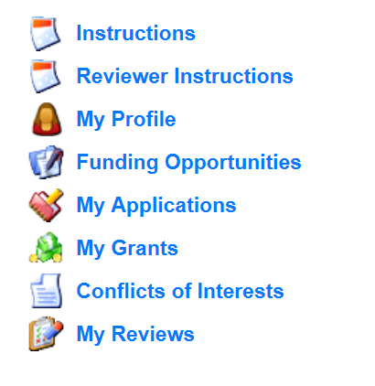
Application Instructions (cont.)
Select “Funding Opportunities” and select the “SFY 2023 Local Violent Crime Prevention (LVCP) Grant” Funding Opportunity

Slide 14
Funding Opportunity
Select SFY 2023 LVCP
The funding opportunity will include a description, attachments, and a link to the LVCP page on the DPS website

Slide 15
Funding Opportunity (cont.)
Funding opportunity attachments will include
SFY 2023 Notice of Funding Opportunity (NOFO)
Application Workshop
Radio Interoperability Guidelines
SFY 2023 LVCP Certified Assurances Form

Slide 16
Application Instructions
After opening the “SFY 2023 LVCP” Funding Opportunity
Select “Start New Application”

Slide 17
Application Instructions (cont.)
After selecting “Start a New Application”, complete the “General Information” section
“Project Title” should be: SFY 2023 LVCP – Your Agency’s Name
After completing the “General Information”, select “Save”

Slide 18
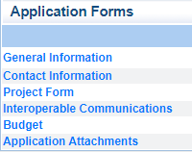
Application Instructions (cont.)
Select “Go to Application Forms”
Complete each of the six “Application Forms” with all required information

Slide 19
Contact Information
Please complete all contact information for
Authorized Official
Project Director
Fiscal Officer
Officer in Charge
**NOTE** The Authorized Official, Project Director, and Fiscal Officer CANNOT be the same person.

Slide 20
Contact Information (cont.)
Authorized Official: The Authorized Official is the individual who has the authority to legally bind the applicant into a contract. Please refer to the list below to help determine the correct Authorized Official for the applicant agency:
If the applicant agency is a city, the Mayor or City Administrator shall be the Authorized Official
If the applicant agency is a county, the Presiding County Commissioner or County Executive shall be the Authorized Official (e.g.; the Sheriff is not the Authorized Official)
If the applicant agency is a college/university, the University President or Campus Chancellor shall be the Authorized Official
If the applicant agency is a state department, the Department/Division Director head shall be the Authorized Official
In order for an application to be considered eligible for funding, the agency’s correct Authorized Official MUST be designated in the “Contact Information” form and must sign the Certified Assurances Form
** If you are unsure who to list as your agency’s Authorized Official please contact the CJ/LE Unit for clarification**

Slide 21
Contact Information (cont.)
Project Director
The person at the agency that is responsible for ensuring that the project is completed and meets all requirements (i.e. Sheriff, Police Chief, etc.)
Fiscal Officer
The person at the agency that can answer fiscal and audit questions (i.e. County Clerk, County Treasurer, etc.)
Officer in Charge
The person at the agency that will be the prime contact (Not a required section, if this person is the same as the Project Director)

Slide 22
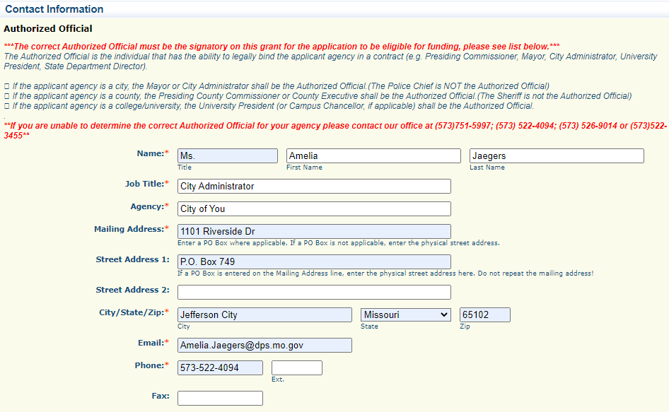
Contact Information (cont.)
Enter the information requested
Required fields are designated with a red asterisk *

Slide 23
Contact Information (cont.)
After all contact information for the Authorized Official, Project Director, Fiscal Officer and the Officer in Charge has been entered
Select “Save” at the top of the screen
After the Contact Section has been saved select “Mark as Complete”

Slide 24
Project Form
Select “Project Form”
Information provided in this section will be used to make funding determinations. Be sure to clearly provide all requested information.

Slide 25
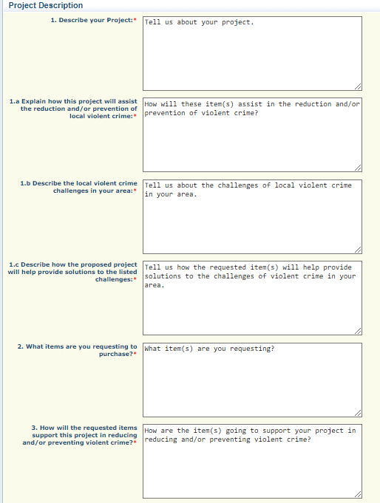
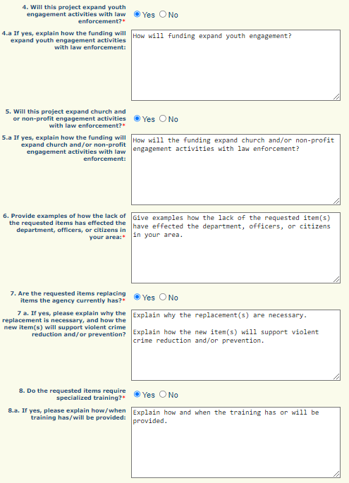
Project Form (cont.)
Project Description information is important, all requested information MUST be provided

Slide 26
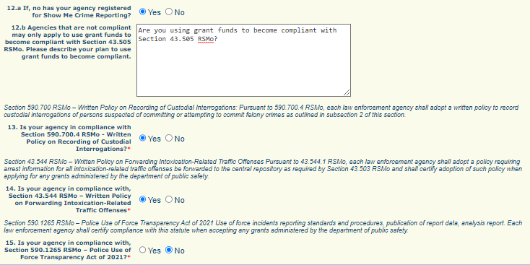
Project Form (cont.)
To be eligible for funding, the applicant agency must be compliant with the listed statutes, along with the additional requirements listed in the Notice of Funding Opportunity

Slide 27
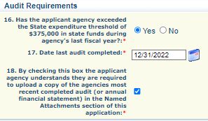
Project Form (cont.)
Audit Requirements

Slide 28
Project Form (cont.)
Audit Requirements
29.200 RSMo (Audits to be conducted at the discretion of auditor or request of governor) allows DPS, CJ/LE (as a pass-through entity) to evaluate each recipients's risk of noncompliance with State statutes, regulations, and the terms and conditions of the award

Slide 29
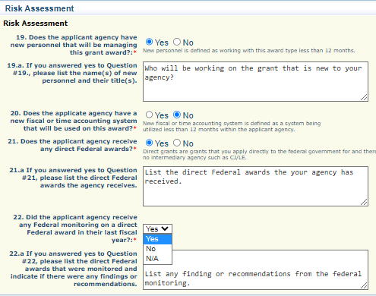
Project Form (cont.)
Risk Assessment

Slide 30
Project Form (cont.)
The Certified Assurances is located at the bottom of the Project Form
The correct Authorized Official must be listed
Applications can be saved without the Authorized Official’s information while they review, but MUST be completed before the form can be marked complete
NEW – Name who has completed the application and their title

Slide 31
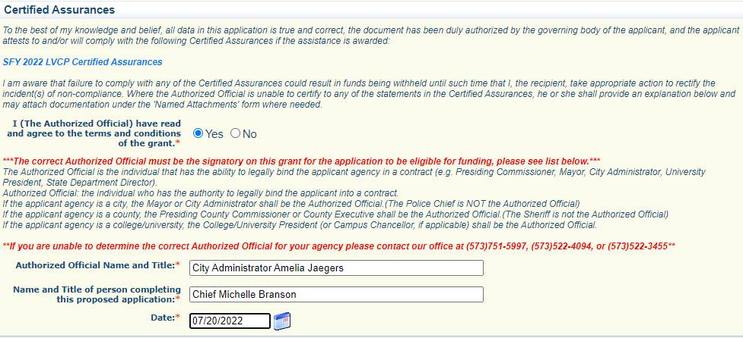
Certified Assurances
The Authorized Official is the individual who has the authority to legally bind the applicant into a contract.
In order to be eligible for the LCVP grant opportunity, the Certified Assurances document MUST be filled in with the applicant agency’s Authorized Official information, after the AO has reviewed and approved the application for submission
The correct Authorized Official must be the signatory on the application to be eligible for funding

Slide 32
Project Form (cont.)
After the Project Form has been completed select “Save” at the top of the page
After selecting “Save” verify that the signed Certified Assurances is signed by the correct Authorized official

Slide 33
Project Form (cont.)
When all information has been added to the Project form select “Mark as Complete”

Slide 34
Interoperable Communications Form
Review the Missouri Radio Interoperability Guidelines before applying for radios
Radio Interoperability Guidelines (mo.gov)
Select “Interoperable Communications Form”
If your agency is requesting radio, this section must be accurately completed to be eligible for funding

Slide 35
Interoperable Communications Form (cont.)
To be P25 CAP Compliant and eligible for Federal or State of Missouri grant funding, radios must meet one of the following encryption requirements
Have no encryption
Have AES 256 algorithm
Have AES 256 algorithm along with any other non-standard encryption algorithms

Slide 36
Interoperable Communications Form (cont.)
Answer Question 1
If you mark the question “No”
Select “Save”
Select “Mark as Complete”

Slide 37
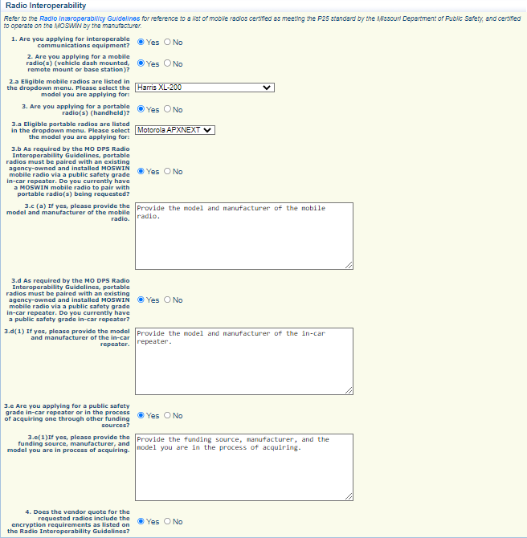
Interoperable Communications Form (cont.)
If you mark the question “Yes”, additional questions will appear
Answer each question

Slide 38
Interoperable Communications Form (cont.)
Once the form is completed, select “Save”
Select “Mark as Complete”

Slide 39
Budget Form
Select “Budget”

Slide 40
Budget Form (cont.)
Enter each budget line by selecting “Add” and completing all required information, then select “Save”
Equipment Item – defined as tangible property having an acquisition cost of $1,000 or more, and a useful life of more than one year. Items that do not meet the equipment definition should be requested under the Supplies category
Supplies – Requested items that do not meet the threshold for equipment

Slide 41
Budget Form (cont.)
To enter the budget, select “Add”

Slide 42
Budget Form (cont.)
To enter the budget, select “Add” and complete the required information and select “Save”

Slide 43
Budget Form (cont.)
Complete the form
Line Name – what is the agency requesting
Budget Category – Equipment or Supplies
Line Description – a brief description of the item being requested
Quantity – how many are being requested for funding
Unit Cost – what is the cost for each individual item

Slide 44
Budget Form (cont.)
Example of Equipment
Select “Save”

Slide 45
Budget Form (cont.)
After selecting “Save” the budget line will be added to the budget
Select “Add” for any additional Equipment and/or Supplies Items

Slide 46
Budget Form (cont.)
Provide required justification for all budget lines by selecting “Edit” at top of the page
Justification for all requested items can be completed at the same time

Slide 47
Budget Form (cont.)
Justification should be provided separately for each equipment line
Identify what is the item(s) being requested
Address how the item(s) will be used
Indicate who will used the requested item(s)
Describe if the item(s) is a replacement, an addition, or something that the agency does not currently have
List the location of where the item will be housed
Agencies applying for mobile radios, portable radios, and/or repeaters must also refer to the “Radio Interoperability Guidelines” for additional justification instructions: https://dps.mo.gov/dir/programs/ohs/documents/RadioInteroperabilityGuidelinesUPDATED-07-18-2022.pdf

Slide 48
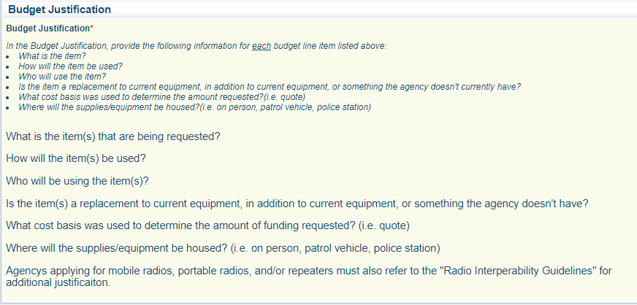
Budget Form (cont.)
Example
Mass edits to the Budget can also be made

Slide 49
Budget Form (cont.)
When the Budget and the Justification are completed select “Save”
Select “Mark as Complete”

Slide 50
Application Attachments
Select “Application Attachments”
To add an attachment select the name of the attachment

Slide 51
Application Attachments (cont.)
Required Attachments:
Most recent audit or Federal Fund Schedule
Recommended Attachments
Quote (Cost basis)
Examples: Vendor quotes, screenshots of website costs, etc.

Slide 52
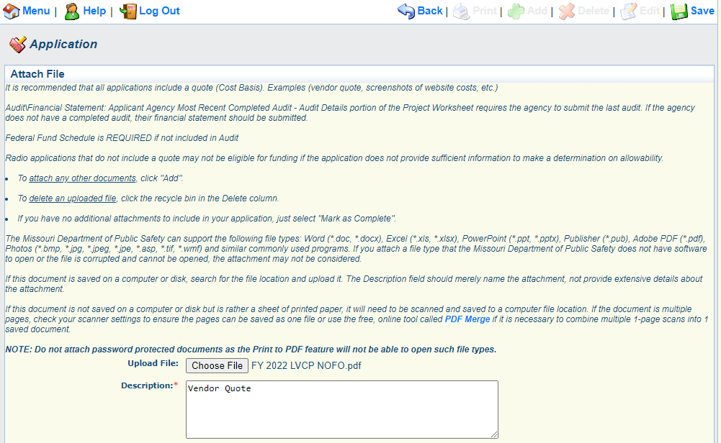
Application Attachments (cont.)
Browse your computer to select document
Add a description to identify the document in the application and select “Save”

Slide 53
Application Instructions
The LVCP application process is competitive, CJ/LE will not request additional information from applicants prior to the funding determination process
Information provided in the application will be used to determine funding, ensure that all necessary information is provided

Slide 54
Submission
All forms must be marked complete in order to submit the application
When everything is complete select “Submit”
All applications must be submitted prior to the deadline of August 16, 2022 at 5:00 pm CST

Slide 55
CJ/LE Grant Contacts
Amelia Jaegers
Lead Grant Specialist
(573) 522-4094
Amelia.Jaegers@dps.mo.gov
Becky Block
Grant Specialist
(573) 522-3455
Rebecca.Block@dps.mo.gov
Liz Leuckel
Grant Specialist
(573) 751-1318
Elizabeth.Leuckel@dps.mo.gov
Michelle Branson
Grant Program Supervisor
(573-) 526-9014
Michelle.Branson@dps.mo.gov
Joni McCarter
DPS Grants Program Manager
(573) 526-9020
Joni.McCarter@dps.mo.gov

